Slide 2
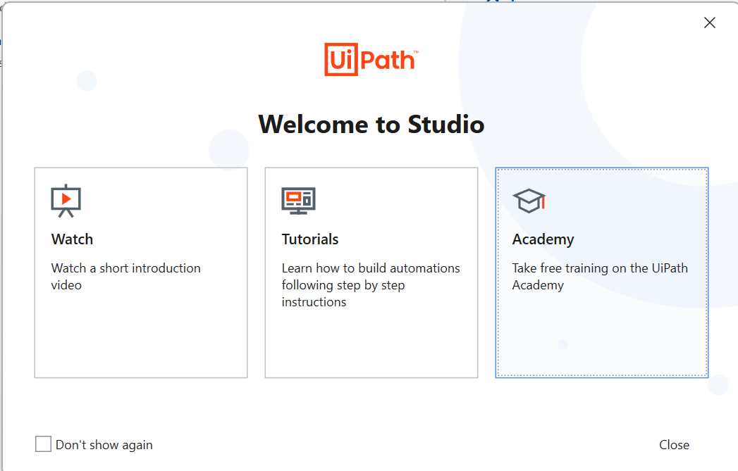
How to get UiPath Cert via the Acedemy

Slide 3
